Slide 1

Evaluating the Impact of Social Media in detecting Health-Violating Restaurants
Sahiti Katragadda
A02222827

Slide 2
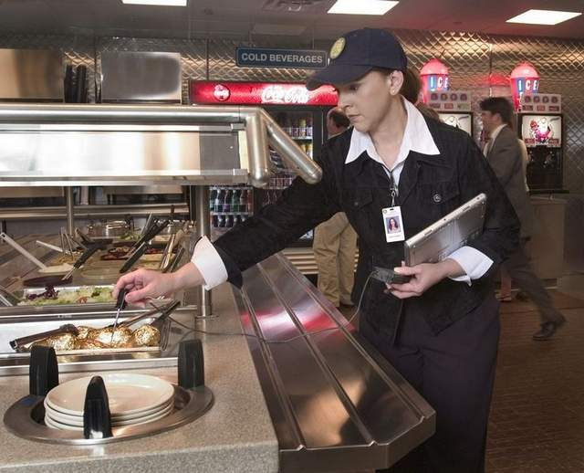
Problem:
Food borne illness – prevented by department of public health.
How?
Inspecting health Conditions of restaurants all over the country.
Annual Inspection checks?
Inspectors – helped by formal complaints,
Many Complaints – reviews on social media
Health Inspectors
Restaurants

Slide 3
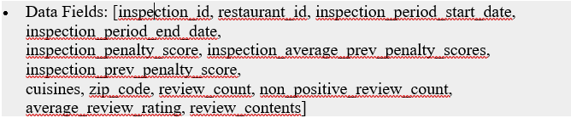
Background
Where not to eat – Reviews + Inspection Records
Data – Reviews for restaurants in Seattle from Yelp
Period – 2006 to 2013
In Yelp – 50% did not have inspection records.
street address into canonical form matching restaurants between Yelp and inspection database.

Slide 4

Focus
Restaurants with severe violations
How to define this?
Score > = t ------ unhygienic
Sentiment of Reviews – restaurants with bad hygiene status – attracts negative reviews( <=3)

Slide 5

Insightful Cues
Hygiene Related words – negative
Sentiment – cheap, never
Service and atmosphere – ambiance
Whom and when? – special occasions
The way the food items are described

Slide 6

Proposed Solution :
Predict restaurant health inspection outcome
New Predictors?
-- Restaurant’s sub area location
-- Previous inspection history
-- Yelp reviews content
-- Yelp User’s behavior
Previous work drawbacks:
Concentrated on a specific city Seattle,
Performances are shown on small datasets

Slide 7

Data
3 data sets – restaurants in Las Vegas, Seattle
Las Vegas Dataset :
Historical records of all restaurant health inspections carried out in Las Vegas from 1990 to Jan 2016.
Las Vegas restaurant meta data + reviews + user’s information extracted from Yelp
This dataset contains – 1,200 Businesses, 17,000 inspections, 13,000 reviews, 65,000 Yelp users.

Slide 8
Data
2) Seattle Dataset – 1,200 Businesses, 9,000 inspections, 150,000 reviews, 43,000 Yelp reviews.
Previous Paper – ignored inspection passed/ not passed labels and
Considered
Inspection – passed ( if inspection grade score >= 50 points )
For Comparison we used this dataset as Seattle_50

Slide 9
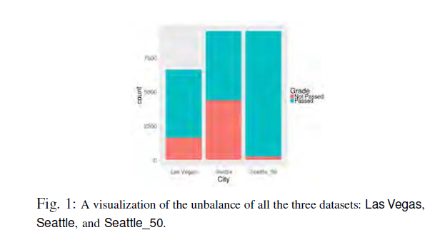

Slide 10
Restaurant’s inspection outcome predictors
1) Restaurant’s location based feature:
Restaurants in good area – more careful with health hazards and will pass inspections more easily
Whole area -- Zip code – too big,
smaller sub areas – locate each restaurant in one of these sub areas.
Technique used – density based clustering algorithm

Slide 11
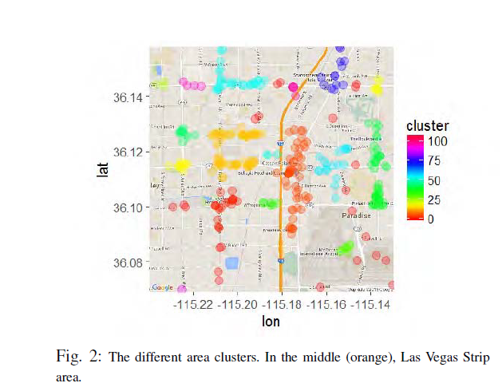

Slide 12
Restaurant’s inspection outcome predictors
2) Past Inspection History based Features:
History of previous inspections – to predict the future outcome of inspection.
Idea: Recurrent offender tends to have a bigger probability to re-offend.
Inspection report contains – types of violations, high/low risk factors, food temperature control , proper use of utensils.

Slide 13
Restaurant’s inspection outcome predictors
Yelp, restaurant review based features:
Idea : To extract information from Yelp – to predict if a restaurant
NLP – analyze review content
Technique used : LDA ( Latent Dirichlet Allocation )
Yelp reviews Main latent topics trying to differentiate reviews dealing with health related topics.
Pass health inspection
Not Pass health inspection
extract

Slide 14
Contd..
After preprocessing yelp reviews, LDA is used to extract meaningful topics.
Trained 2 separate LDA models ( 40 for each ) for discovering topics specific to each class ( passed and not passed inspections)
Reviews
Positive ( review score >=4 )
Negative ( review score <=3)

Slide 15
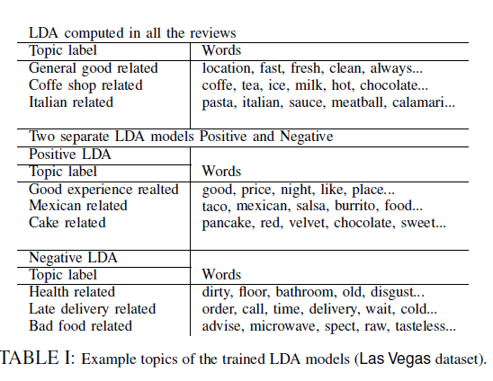

Slide 16


Restaurant’s inspection outcome predictors
4) Yelp Users Behavior Based Features:
Average Normalized Review Score:

Slide 17

Restaurant Authority – Feature for Classification
HITS ( Hyperlink-Induced Topic Search)
Each page – 2 scores
Good hub – points to many other pages
Good authority – page linked by many different hubs.
w(u,r) = 1
w(u,r) = s(u,r)
w(u,r) = 5 – s(u,r)

Slide 18
User Filtering
Elite Status – review quality, authenticity, and contribution to the network.
Fake reviews
All reviews for r -- weighted average of all review scores,
where w = 3 (elite user) or 1 otherwise.
Weighted mean – 2 SD away from this, are filtered out.

Slide 19
Experiments
Different classification algorithms are used – Linear SVM, Logistic Regression with l1 and l2 regularization, Random Forest.
To extract Latent topics from Yelp reviews – LDA
Gibbs Sampling – for parameter estimation and inference
2 experiments – measured performances of 10- fold cross validation of all features with and without history based features.

Slide 20
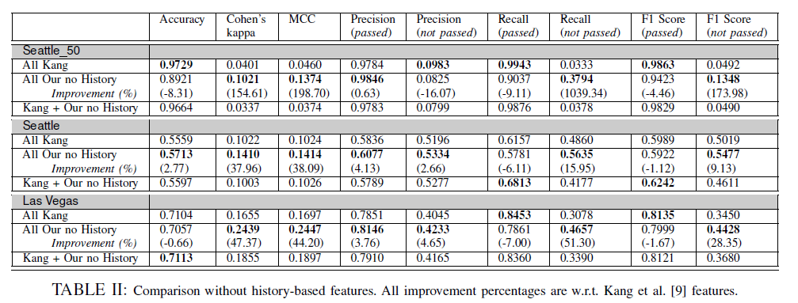

Slide 21
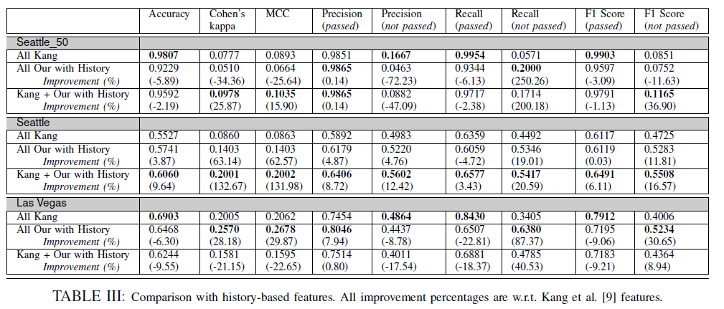

Slide 22
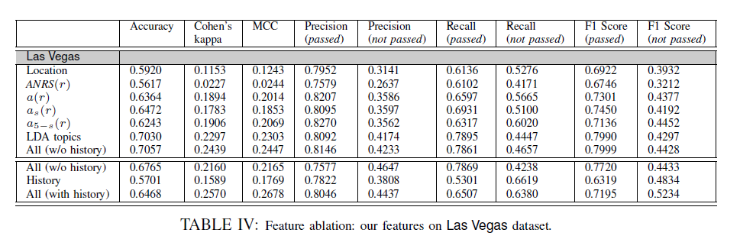

Slide 23
Inspector Simulation Model
1 inspector – does at least K inspections in a sequence
2 cases – with and without classifier
Goal – To find the no. of restaurants that did not pass the inspection

Slide 24
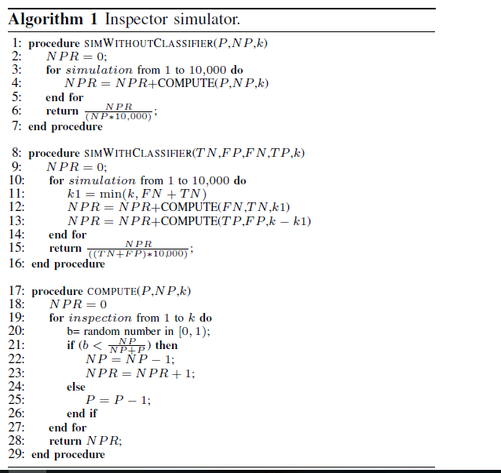

Slide 25
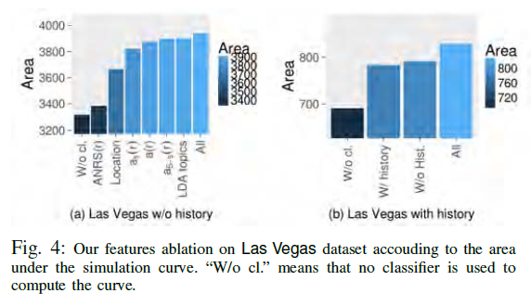

Slide 26

Strengths
Many Restaurants do not have hygiene grades – approx. grade is predicted
Improvement in performance by 16% compared to past work in terms of Cohen’s Kappa Coefficient and Mathew’s Correlation Coefficient.
Evaluates the benefit of the classifier, thereby improving the ability of the inspector .

Slide 27

Weaknesses
Customers – do not inspection codes not have full access to kitchen.
Reviews – may not be useful sometimes as they do not contain health related issues.

Slide 28
Conclusion
Prioritizing restaurant health inspection by using classification techniques.
Defined set of features for prediction task.
Improvement in performance measures.
Effectiveness of a classifier.

Slide 29
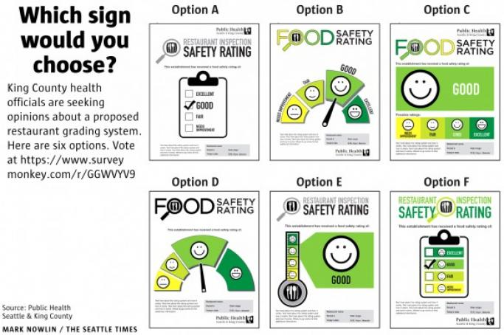
My Insights
However no improvement in accuracy.
Reviews

Slide 30


